Slide 1

Software Engineering
DR. MD. RAZIB HAYAT KHAN

Slide 2
Group:12
Sams, A.B.M Toufiqul Alam 19-39297-1
Sufian Mustaq 19-39292-1
Costa, Piu Teresa 18-38286-2
Sanjida Junak Priya 19-40173-1

Slide 3
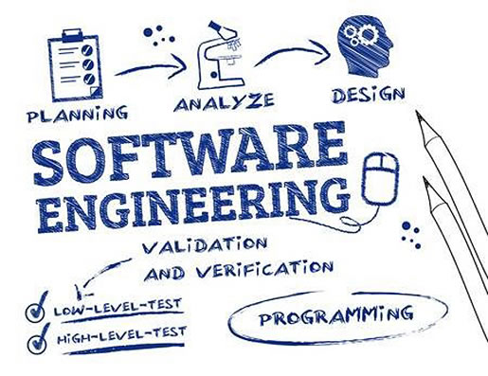
For my personal point of view this course gives us basic knowledge for IT industry. We have learn many thing some fundamental like:
1.Diagrams.
1.1 Activity diagram
1.2 Use case diagram
1.3 Class diagram
1.4 Er diagram
2. Mock design
3.Project requirement 4.project estimation
We have learn some model and module or system for completing a project in oriented, clearly and timely.
Like waterfall model XP model etc. we will discus everything base on our project.

Slide 4
One Time Renting
What is OTR(One Time Renting):
OTR is one-time renting app. One-time renting mean you can take or give rent something.
You need something just for few mints but you can’t avoid it because its really important for that moment its expensive as well so let’s rent it. On the other hand, you have something that’s really no more useful for you anymore or it may need but for this time been its useless for you so give it as rent.
Here will be two actor one is owner and another one is customer. You can act like both.
What is app for:
This app is just for use as a media renting. You can rent your thing and you can have some if you need. It will save your money and also can give you some money as well.

Slide 5
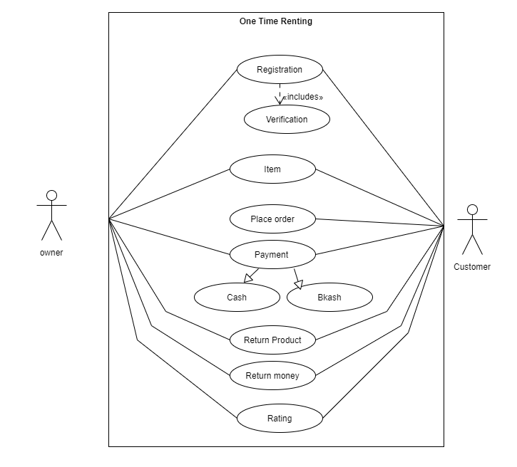
Use Case Diagram

Slide 6
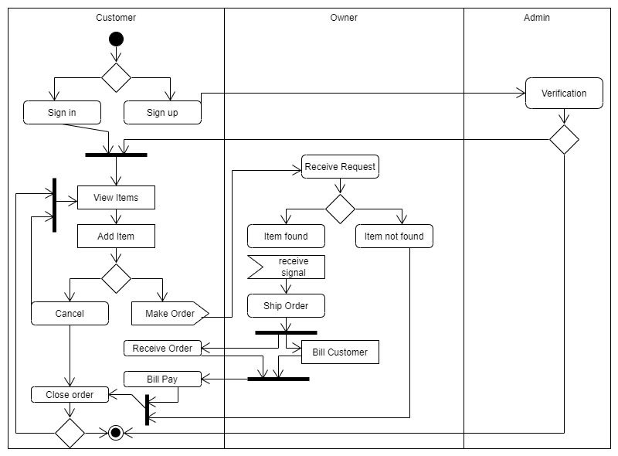
Activity Diagram

Slide 7
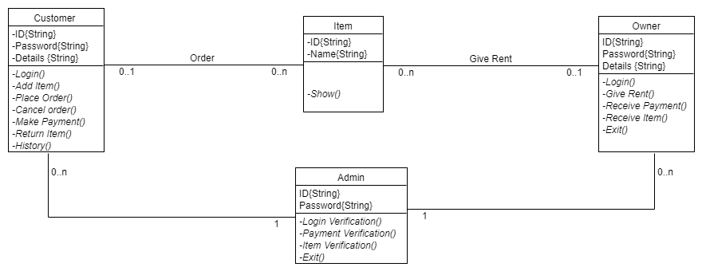
Class Diagram

Slide 8
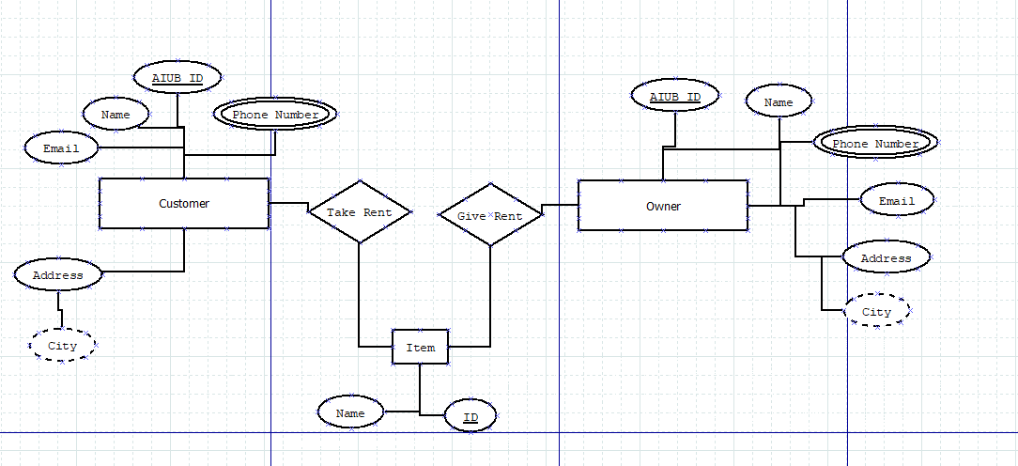
ER diagram

Slide 9
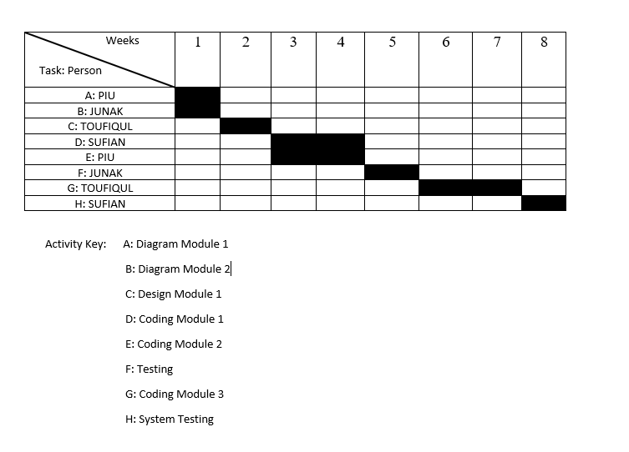
Time Tabel

Slide 10
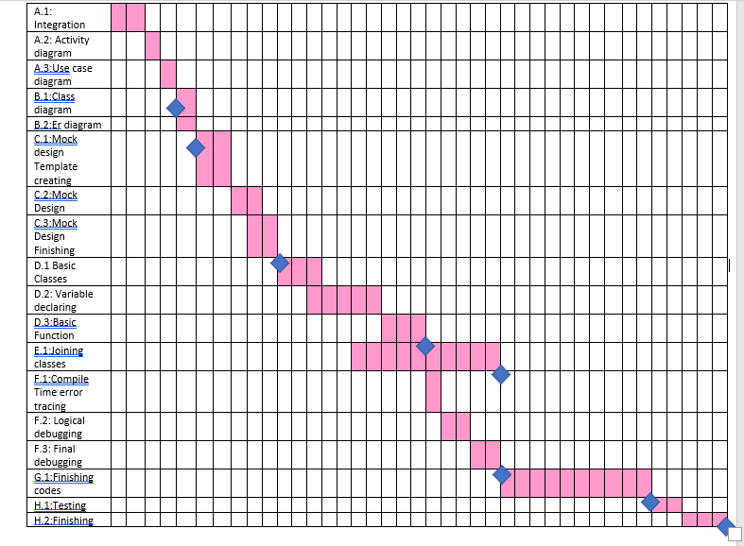

Slide 11
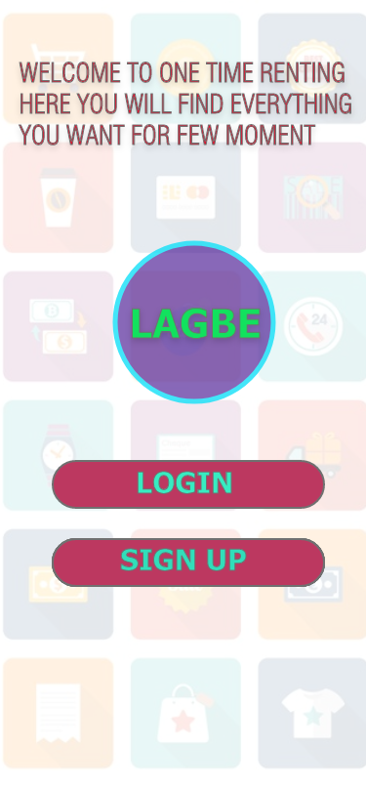
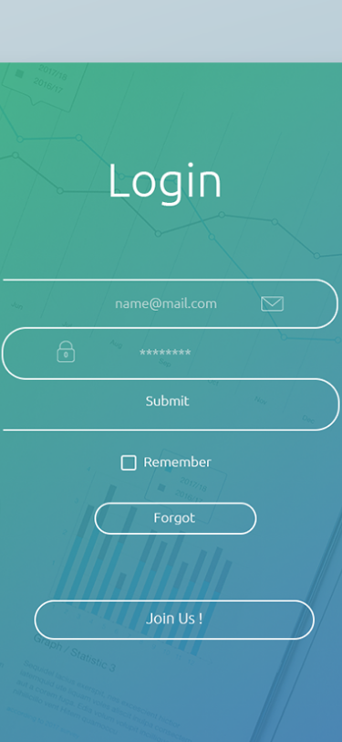
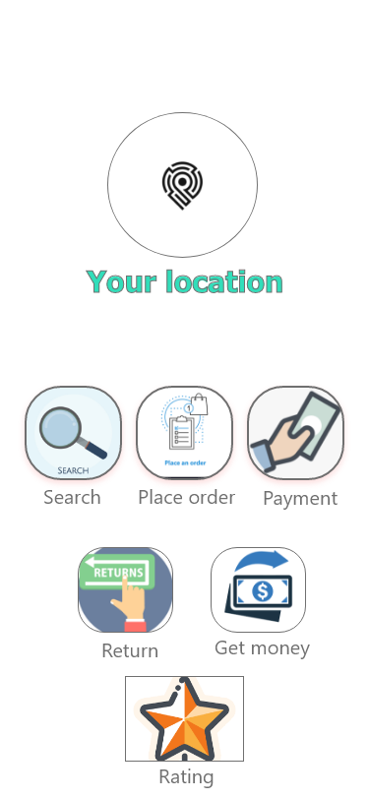
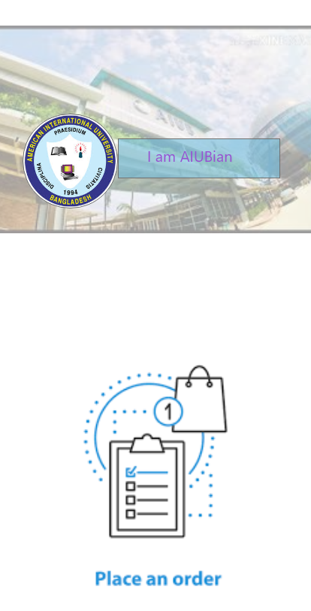
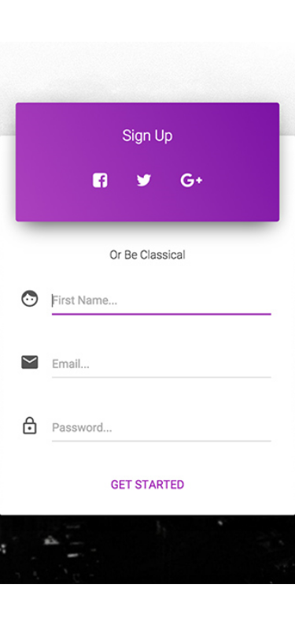


Slide 12
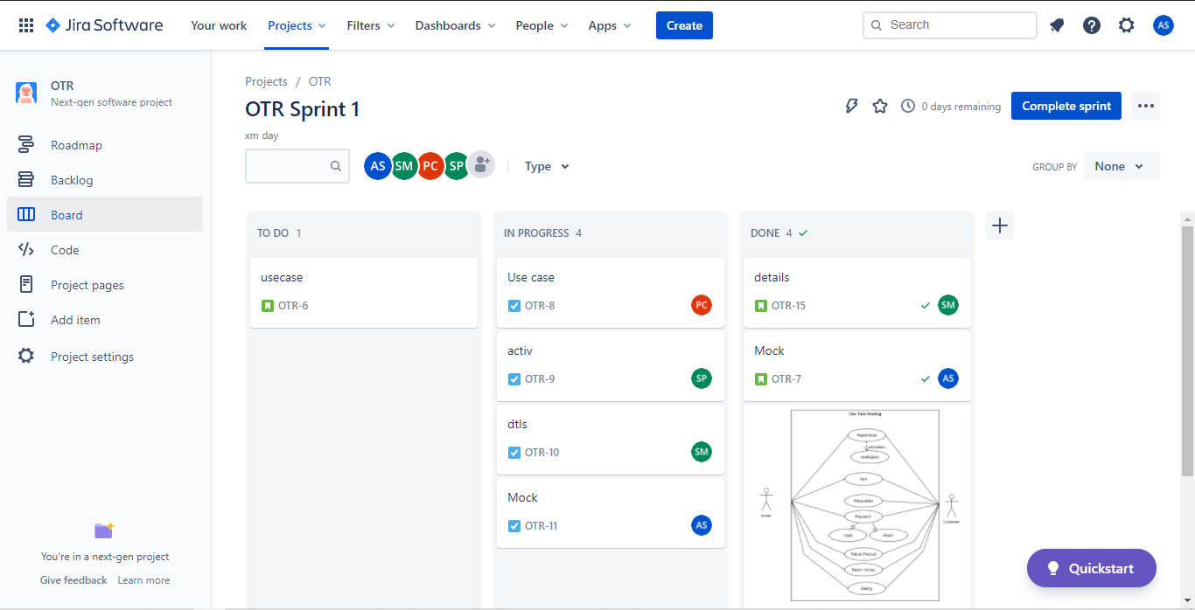
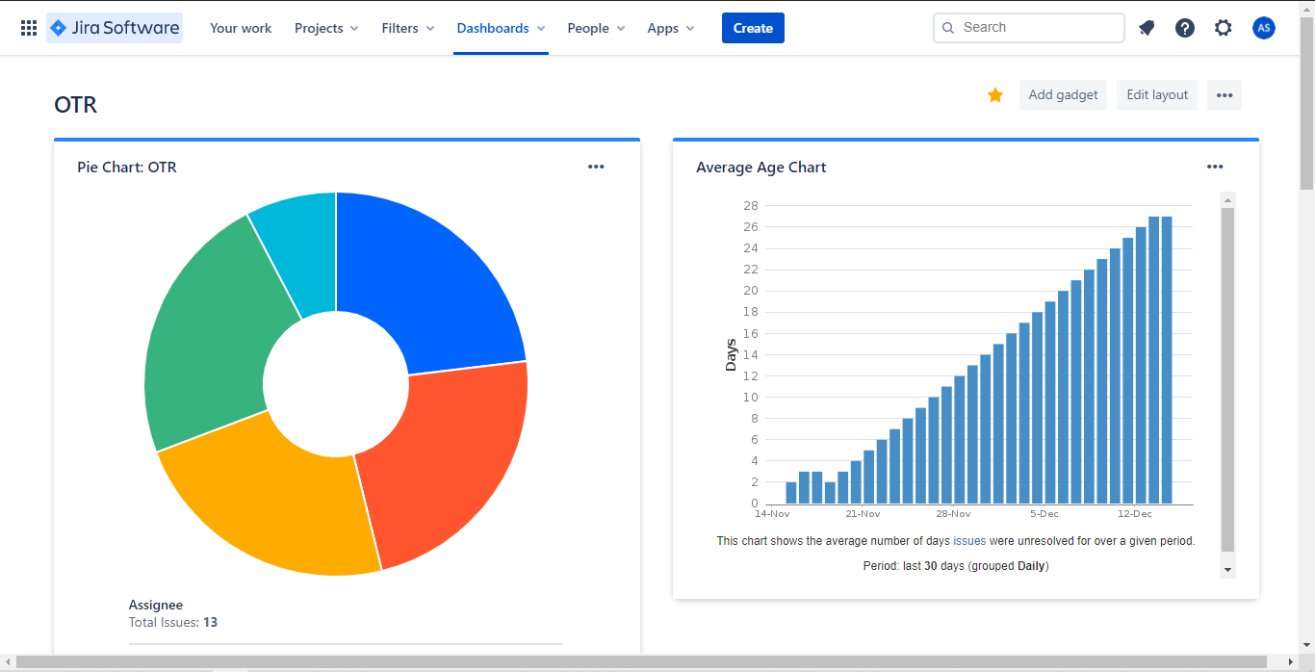
Jira:

Slide 13
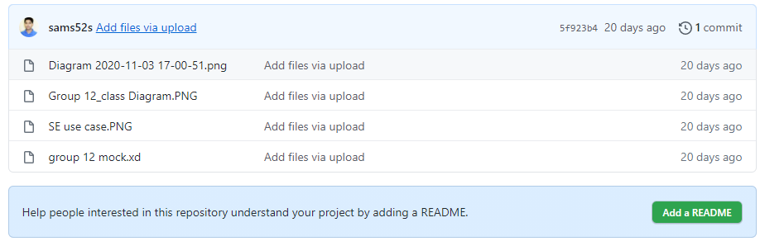
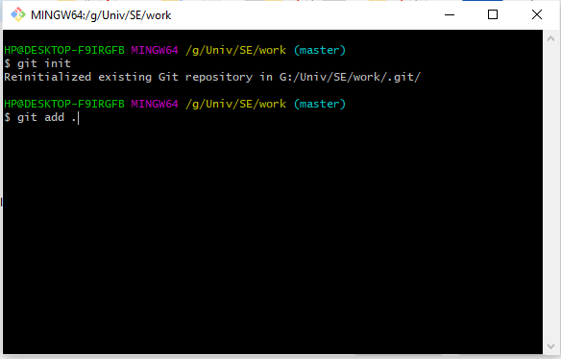
GIT:

Slide 14
Project Estimation :
Charge for requirement analysis=120*300=36000
Travel expense=20000
Office rent expense=30000*9=270000.
Electricity & Gas bill=2000*9=18000
Training and hardware cost=100000
Maintenance for 9 months=9*8=72 hours
Maintenance cost=72 hours*1500
=108000
Utility cost:
Per month cost 5000 tk
Total = 9 months*5000 =45000 tk
Total cost=680000+36000+20000+270000+18000+100000+108000+45000
=1007000
Bill=Total cost+20%=1007000+201400=1208400=
1208400.
One time renting app is not that much big, so we can say it’s an organic model, and let’s assume we will develop in java language. so Source lines of code, SLOC=12000.
We know Effort =PM=Coefficient*(SLOC/1000)^P.
For organic project type,
Coefficient = 2.4, P = 1.05, T = 038.
So
Effort =PM =2.4*(12)^1.05 [SLOC/1000=12000/1000=12]
=32.61 staff-months
=33 staff-months
Development time = DM = 2.50*(PM)^T
= 2.50*(33)^0.38
= 9.44 month
Let take it as 9 months
Required number of people=ST=PM/DM
= 33/9=3.67 = 4 Working hours per day for a single person=8 hours
Per person salary in a month=85,000
Per hour salary for a person in a month=85,000/180 [In a month working hours= 180]
=472.22
In 9 months number working days=180
Hours =180*8
=1440 hours So, Charge for the project 1440*472.22
=679996=680000
Requirement analysis =15days*8hours
=120hour

Slide 15
Conclusion:
As, we are making an software named, ONE TIME RENTING (OTR), used as a media renting app by which anyone can easily borrow & lend things using this app. By this app we can do a trouble free renting & at the same time we can save our money & time. In the SE course we've learned each & every possible steps for developing our software successfully.

Slide 16


